Slide 1
Incubyte – Data Engineer
Assessment

Slide 2
Technical Assessment: Deliverables
1. Create table queries: -Included 2. And any script or program which reads the data: -Python script.
Tools Used:-
Jupyter notebook
Sql Server Management studio

Slide 3
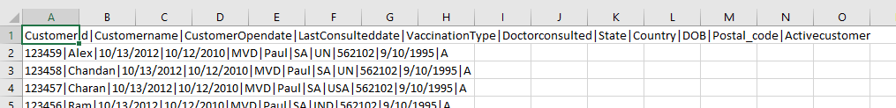
Source
Here I used CSV file with delimiter “|”
Here is the sample

Slide 4
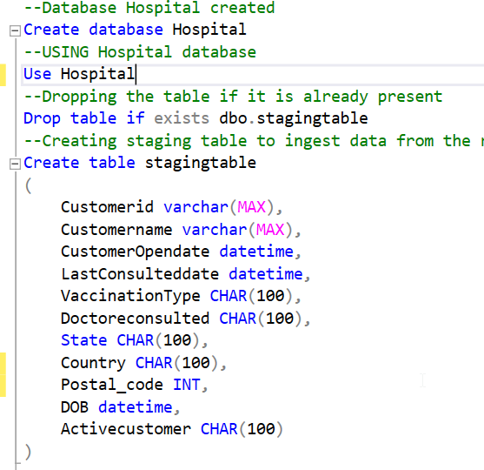
Destination System
Here I used SQL Server Management system.
Created Staging table to load the data from Source system.
Database name: -Hospital, Table name: - dbo.stagingtable

Slide 5
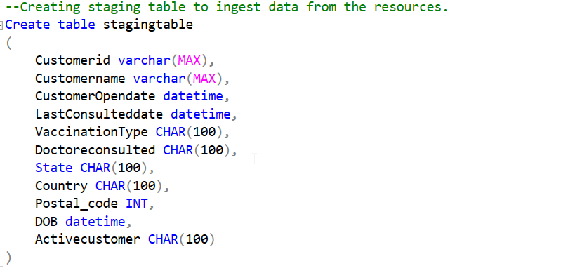
SQL Code
To Create Table

Slide 6
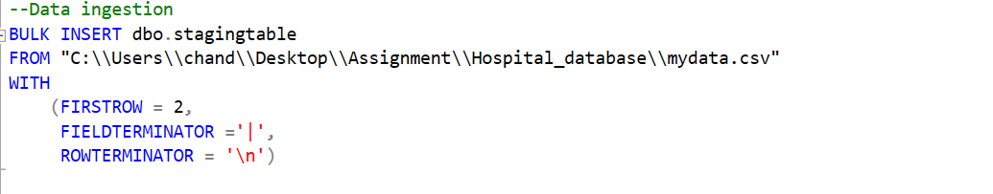
To insert data

Slide 7
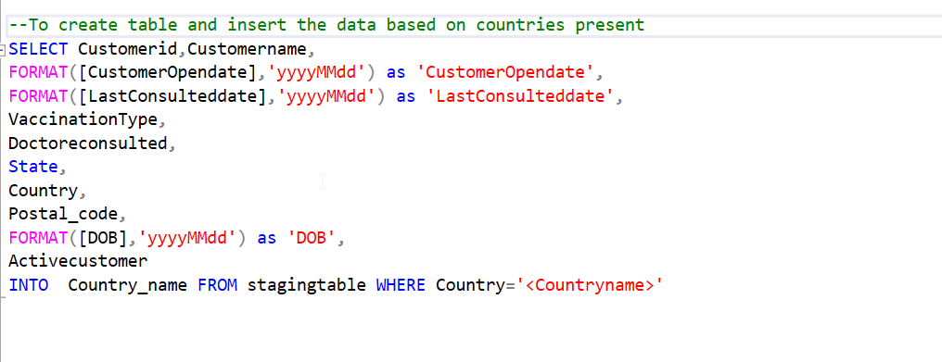
Creating specific country table

Slide 8
Python script
The script follows OOPS concept.
The class Hospital have init, creare_table, bulk_insert, Country methods.
I am passing Server name, Database name and File name explicitly.
Please note:- Screenshots that attached may not have snapshot of full code. Please refer python script

Slide 9
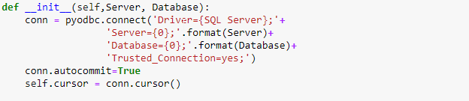
Init method
Which helps to connect to the Server and Database

Slide 10
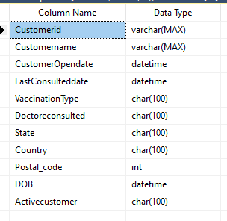
Create table
To create intermediate table/staging table

Slide 11
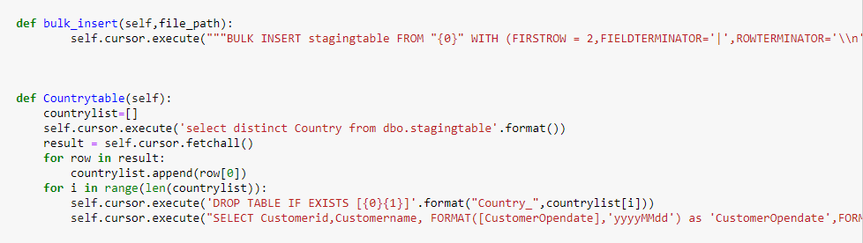
Insert and Counrty methods

Slide 12
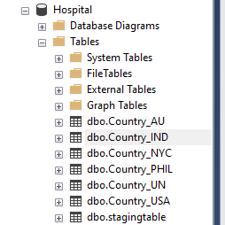
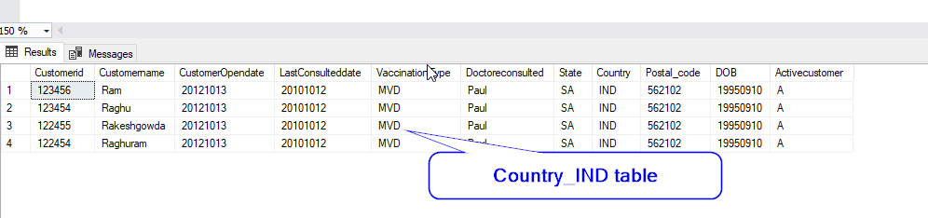
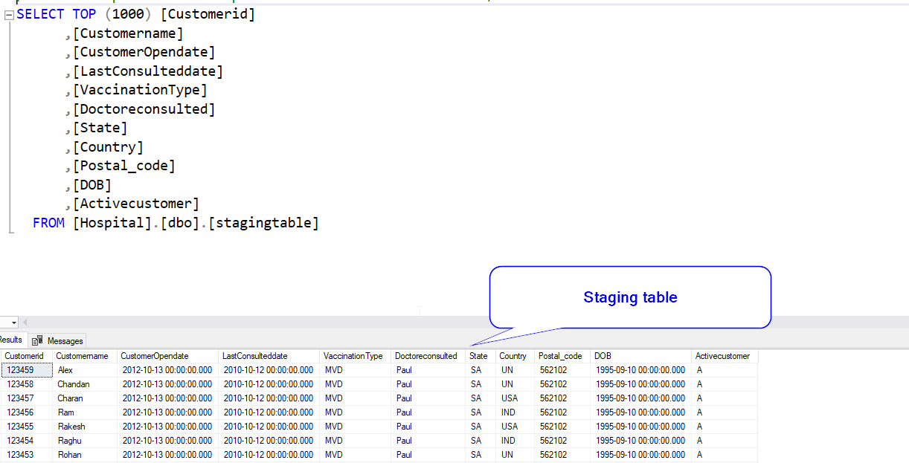
Outputs

Slide 13
END

